Slide 1
1. Models and how things are kept done in simple way

Slide 2
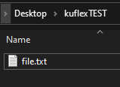
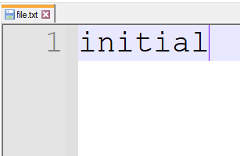
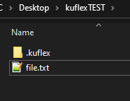
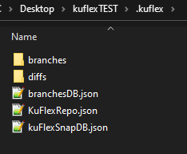
Project Directory
This is a test project directory
This is the content of file.txt
lets Initialze KuFlex Repo
This are the files and folders created after we initialze a repo

Slide 3
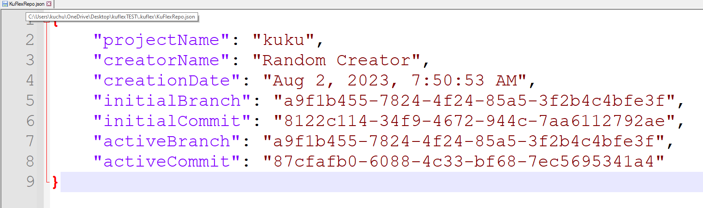
KuFlexRepo.json
Repo file that holds information about the repository and the state of the repository
When we create a repo. We also create an initial branch
When we create a branch we automatically create an initial commit for that branch as well.
We save their ID as the initial branch and Commit
We also set the initial branch and commit as the active branch and commit

Slide 4
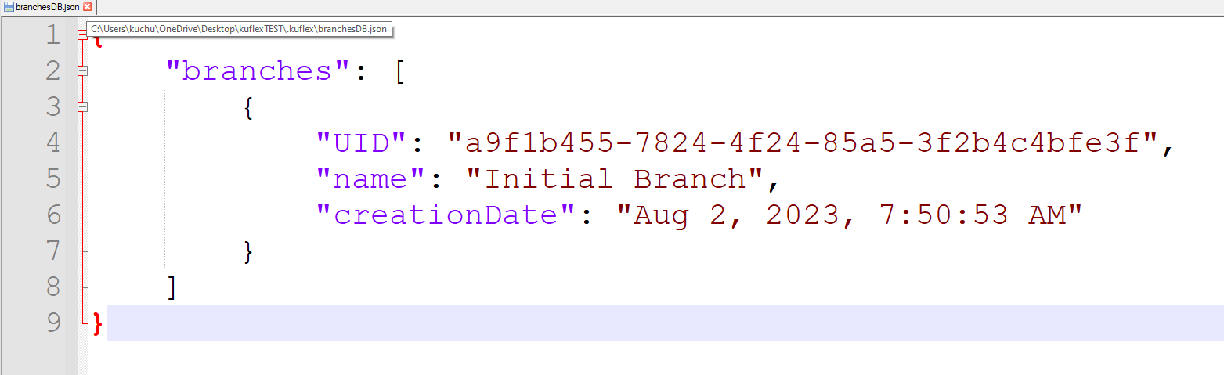
BranchesDB.json
Holds record of branches created. Upon initialization of repo we will have one branch record in BranchDB which is the initial branch. The IDs will match between the Id of the initial branch in branchDB and the ID of initial branch field in repo
KuFlexRepo.json

Slide 5
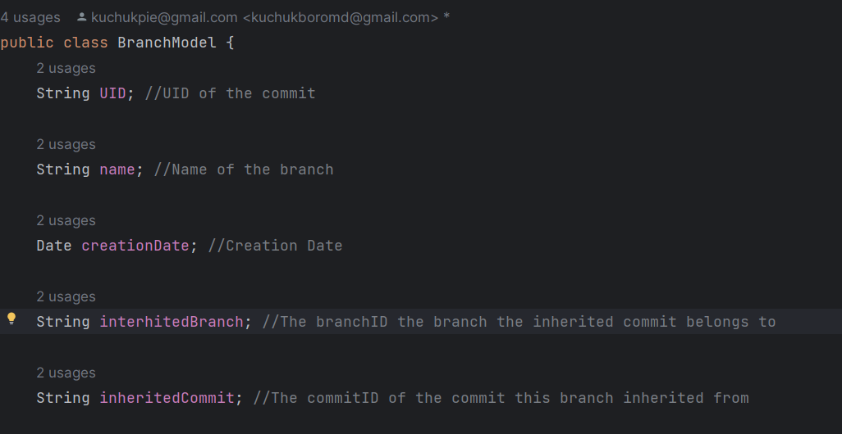
Branch Model
This is what a branch model looks like. Initial branch has inheritedBranch and inheritedCommit missing because it is the FIRST branch. The branches we make in future will have inherited commits and branch

Slide 6
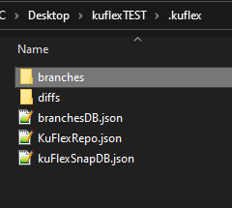
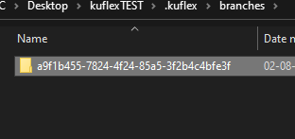
Branches directory
The name of the directory will be named after the ID of the branch. In our case we have one folder whose name matches the ID of the initial branch. Meaning this folder is for the initial branch
Every branch will have it’s own dedicated directory found in branches directory
initial branch entity in branchDB

Slide 7
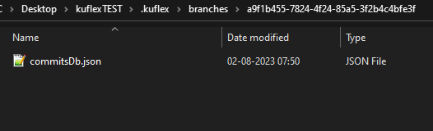
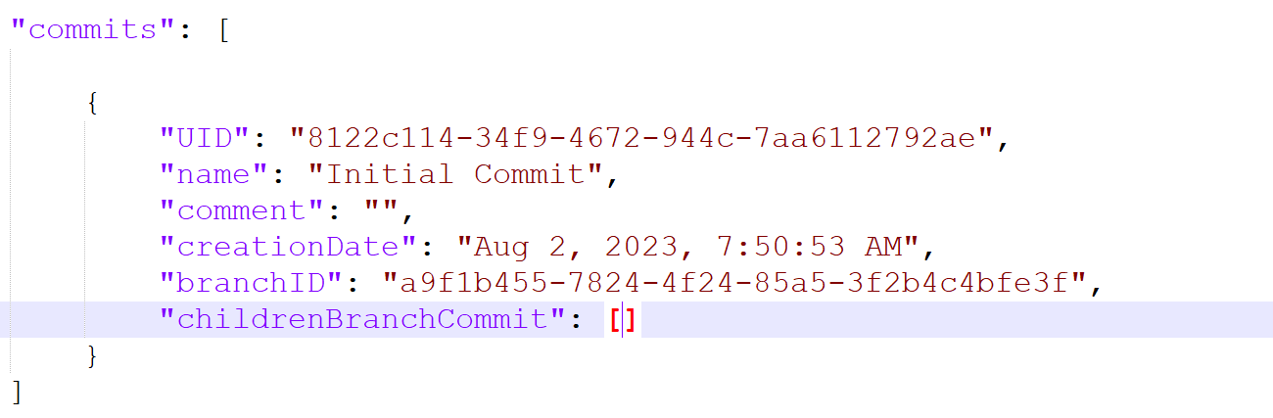
CommitDB.json
Every branch directory will have a CommitDB.json database.
It will hold all the commits that were made for that branch
We have one commit in commitsDb and it is the initial commit.
Every field is self explanatory execept childrenBranchCommit.
It will hold a list of commitsID that inherited from this commit.

Slide 8
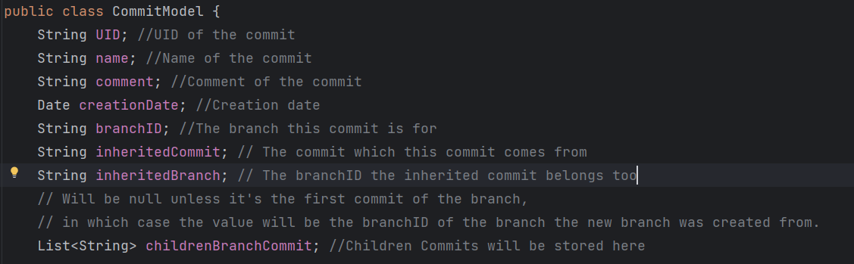
Commit Model
A commit will inherit from another commit. The reason initial Commit has no inherited branch and commit because
it is the initial commit and doesn’t inherit from any commit. The commits we make in the future will inherit another
existing commit.

Slide 9
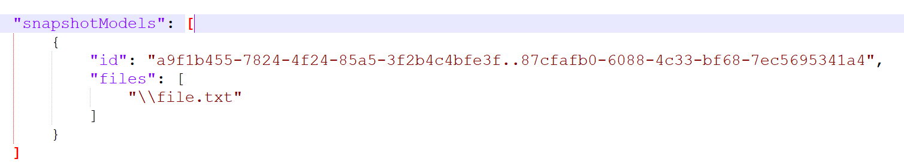
SnapshotDB
When we make a commit we create a snapshot. The snapshot’s ID will be the combination of “branchID..CommitID”
of the commit.
Snapshot holds a list of file Paths that exist during the commit.

Slide 10
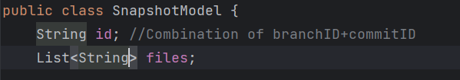
Snapshot model
Snapshot model is very simple.
All it has is an ID which is a combination of branchID and commit ID that the snapshot belongs to
And a list of string that is going to represent the filePath of every file in the project during the commit.

Slide 11
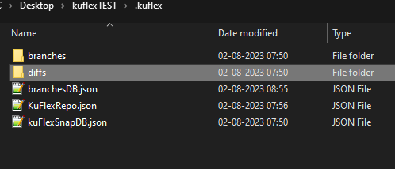
Diffs
Files go through changes as project evolves and we we make more commits. We track the changes of each file in the project. We refer to the changes as “Diffs”. We designed KuFlex VCS in such a way that each file will have it’s own “DiffDB” database which will hold a list of “diffs” that the file went through as we made more commits.
For every commit we make we create a new diff record for a file in it’s “DiffDB”.
All the DiffDB are stored in diffs directory

Slide 12
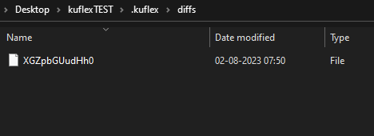
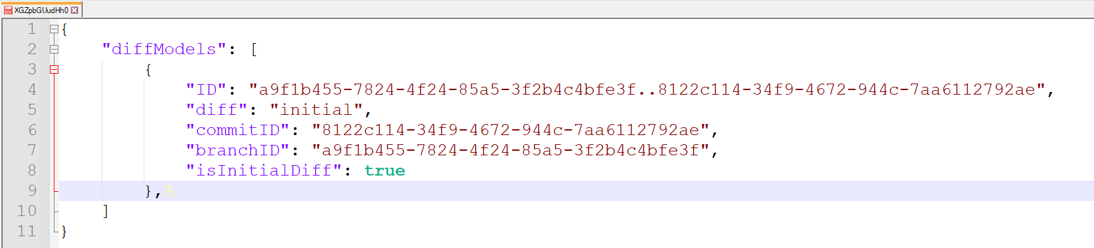
Our project has only 1 file which is “file.txt”
inside the diffs directory we have a file with
a weird name. This is the DiffDB file for “file.txt”
in encoded format.
DiffDB has a diffModel record in it. Just like snapshot it’s ID is a combination of branchID..CommitID of the commit it belongs to.
“diff” field holds the diff data for the file.
For initial DiffModel record the value of diff field is simply going to be the copy pasted content
“isInitialDiff” is very important. It helps us to determine which record is the initial diff. This is important as our diff algorithm
is chain based

